Slide 1
Loops……….

Slide 2
Loops can execute a block of code as long as a specified condition is reached.
Loops are handy because they save time, reduce errors, and they make code more readable.

Slide 3
Types of Loops.
For Loop:
The "for" loop is often used when the number of iterations is known in advance. It works by initializing a loop counter, checking a condition, and incrementing the counter after each iteration.
While Loop:
The "while" loop is used when the number of iterations is not known in advance. It works by checking a condition before each iteration and continues executing the loop as long as the condition is true.
Do-While Loop:
The "do-while" loop is similar to the "while" loop, but it checks the condition after executing the loop's body. This guarantees that the loop will run at least once, even if the condition is false.

Slide 4
For Loops

Slide 5
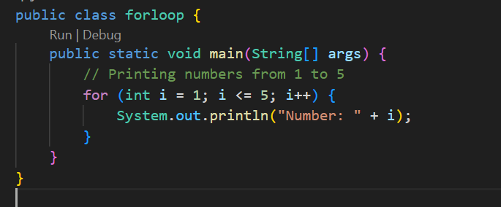
Java

Slide 6
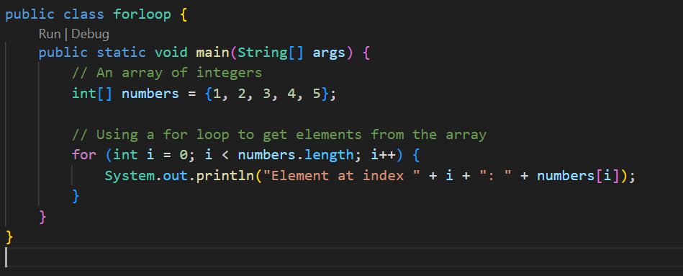

Slide 7

Python

Slide 8
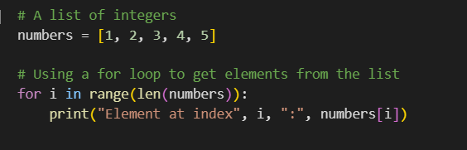

Slide 9
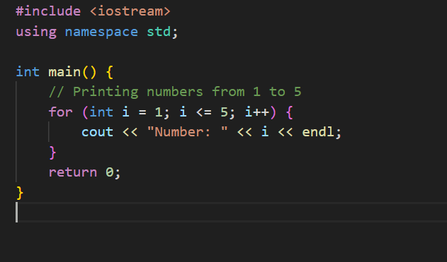
C++

Slide 10
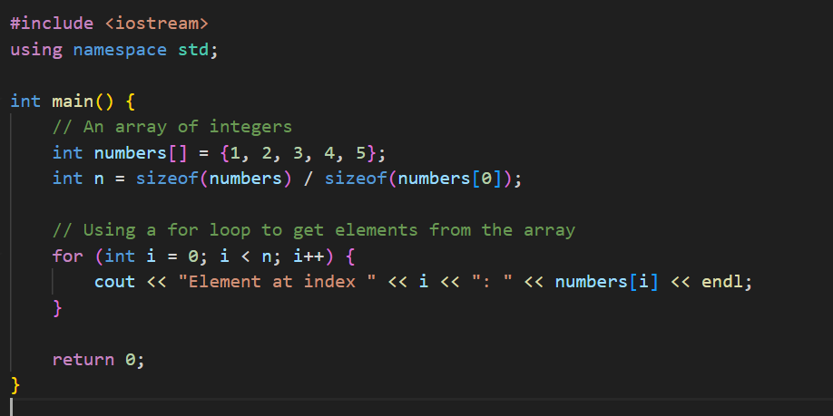

Slide 11
Tasks……..
Write a program to print the multiplication table of a given number.
Write a program to print the even numbers between 1 and 50.
Write a program to find the sum of all elements in an array of integers.
Write a program to find the largest and smallest elements in an array of integers.
Write a program to find the factorial of a given number.

